Slide 1

Real Time Anomaly Detection With Stream Analytics

Slide 2
Samara Soucy @oneangrypenguin samara.soucy@microsoft.com
Software Engineer – Microsoft MCP – C#

Slide 3
Demo Preview:
sademo.azurewebsites.net

Slide 4
What is Stream Analytics and Why Do I Care?
Stream analytics offers insights and predictions in real time
Can Handle processing large amounts of data- designed with IoT in mind
Basic anomaly detection is built in, but custom functions and machine learning integration allow flexibility in analyzing data
Allows users to respond to issues as they occur, or even before a situation becomes a problem
Notes:
Run SQL queries in real time against a stream of data.
Imagine trying to run queries against 24 hours of data every time a single row is updated.
Allows for spotting trends and anomalies based on recent data combined with additional reference data.
Exactly once processing of inputs & at least once delivery of outputs
Built in job recovery, and checkpointing to help restart a job in the middle if a job is stopped in the middle of running.
Built on the Trill engine, which Is an in-memory relational engine
Temporal model – preserves history as well as current state
Has the ability to start processing on partial data (aka when the job first starts it will not have results for the full time period)
Use case within the demo- see if equipment is overloaded or a machine is possibly failing.

Slide 5
Data Stream Process
Input Data
OutPut Data
Stream Input:
Event Hub
IoT Hub
Blob Storage
Reference Data:
Blob Storage
Azure SQL (Preview)
SQL DB
Blob Storage
Event Hub
Service Bus
Power BI
Table Storage
Cosmos DB
Functions
Magic!
Notes:
Why those specific sources are the only ones allowed.
Needs to be able to notify Stream Analytics that new data is available.
Needs to allow reading historical data (aka no Service Bus)
IoT Hub is a bit of a special case- SA is built into IoT Edge and uses a different pricing model
Blob Storage input primarily exists for analyzing log files
As of 5/5 Cosmos DB support as an input was under review by the product team.
Difference between streaming data and reference data.
Stream Data is the stuff you are looking to analyzing
Reference data contains meta data about the objects you are analyzing.
DW terms stream = fact table, reference = dimensions

Slide 6

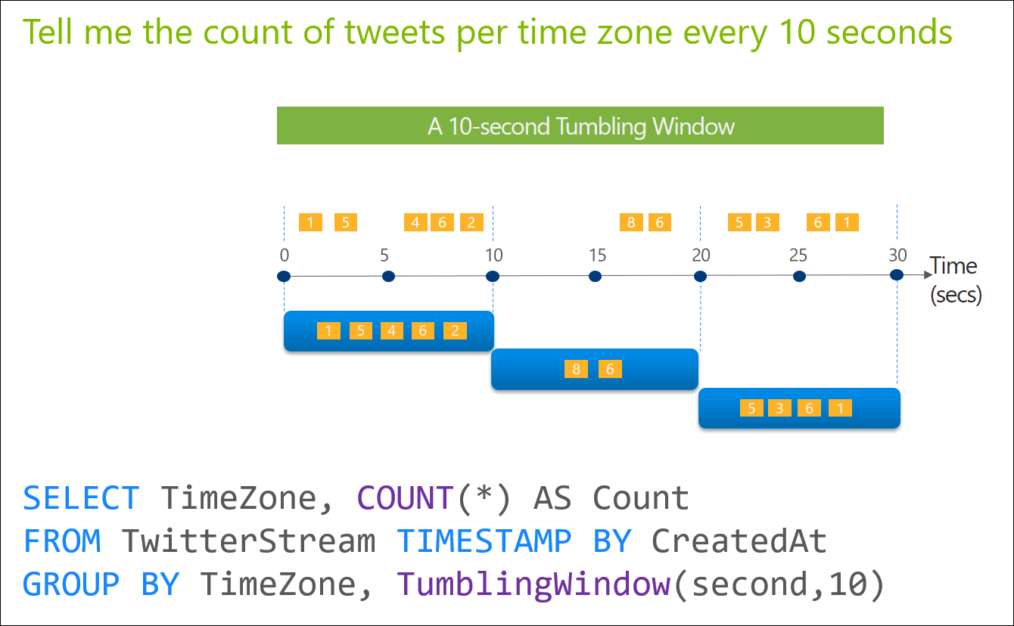
Query Language
SQL Subset, buuuuuut… a couple things are a bit different.
Windowing Functions - how to clump data over time.
Analytic Functions – how to train the model
Late and Out of Order event policies
Notes:
But you said it was just SQL! Mostly SQL, but there are some differences to handle input/output and data windowing.

Slide 7
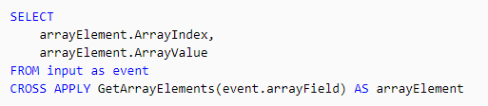
Query Language
Working with JSON & AVRO
GetArrayElements, GetArrayLength
GetRecordPropertyValue
Property name is unknown
Notes:
But you said it was just SQL! Mostly SQL, but there are some differences to handle input/output and data windowing.

Slide 8
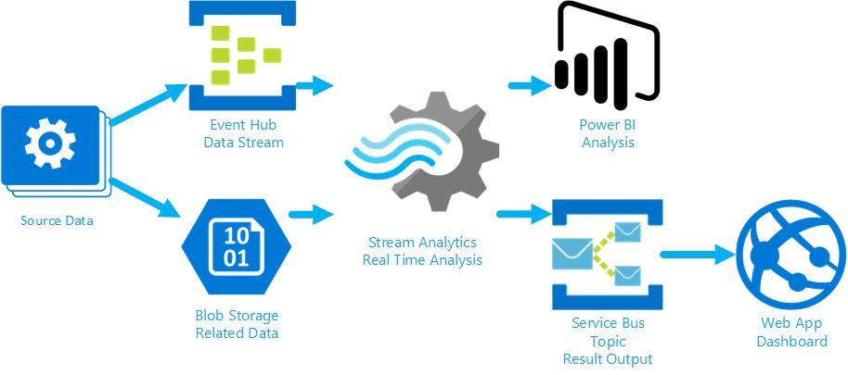
Demo Architecture

Slide 9
Resources
Trill engine: https://github.com/Microsoft/Trill
Documentation: https://docs.microsoft.com/en-us/azure/stream-analytics/
MSDN Forum: https://social.msdn.microsoft.com/Forums/en-US/home?forum=AzureStreamAnalytics
Code:
https://github.com/serri588/streamanalyticsdemo

